Slide 1


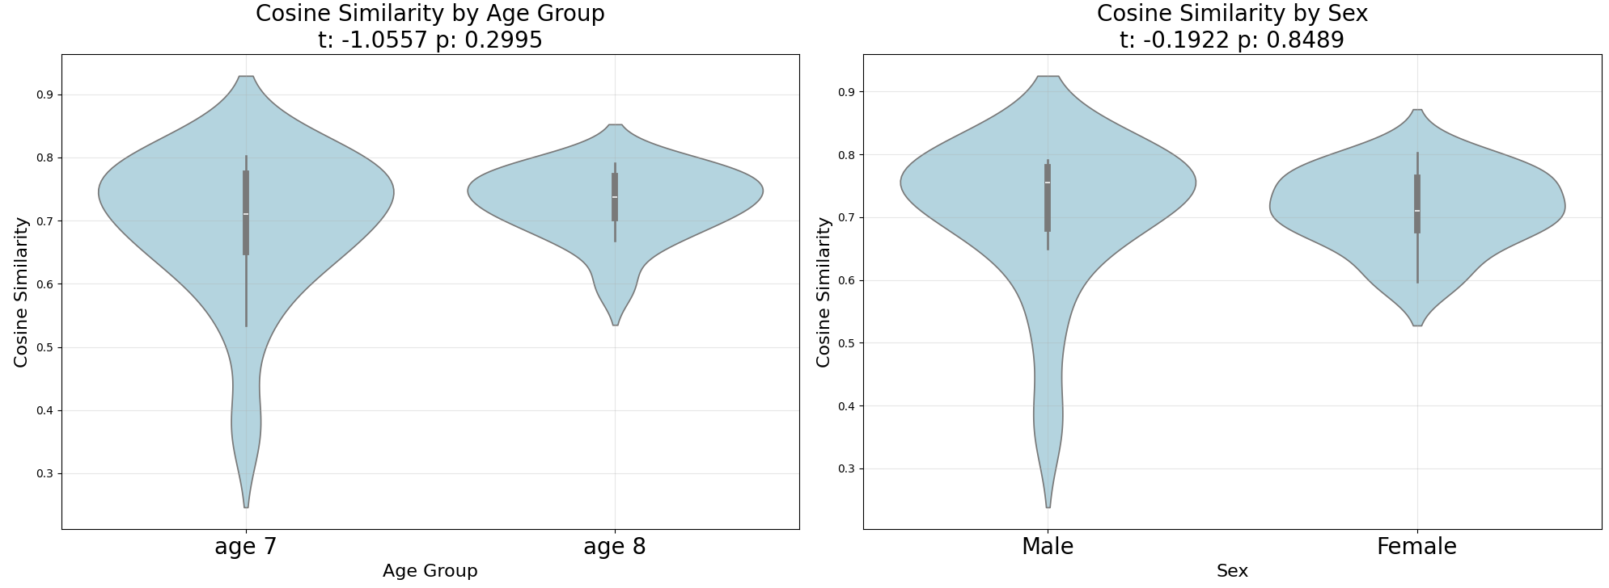
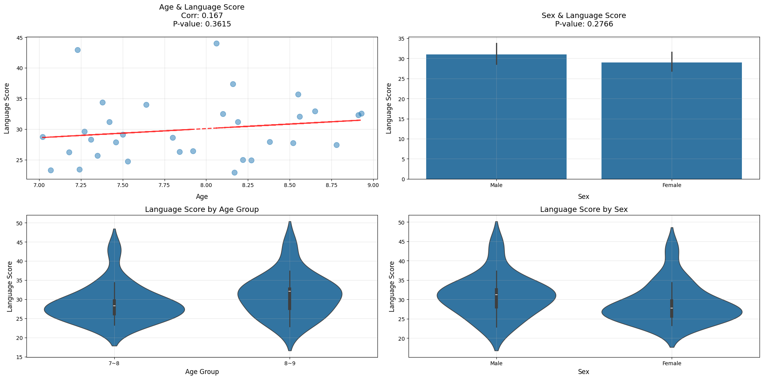
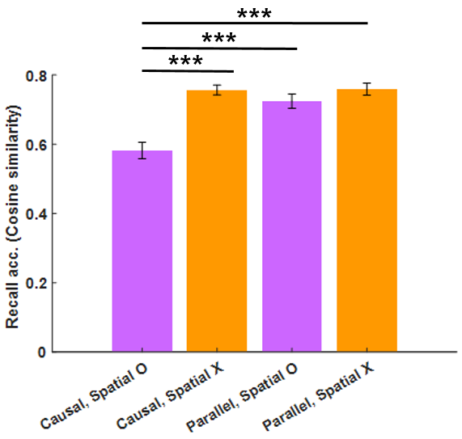
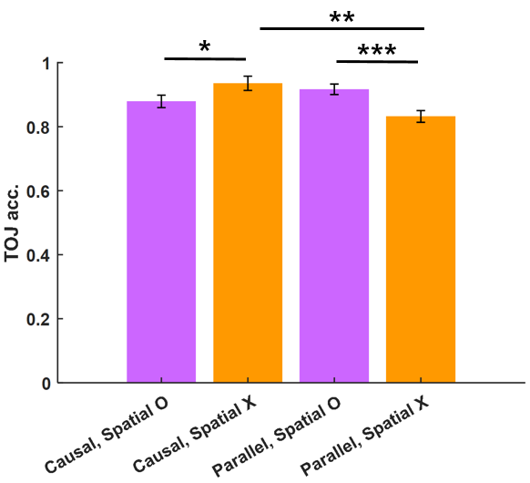

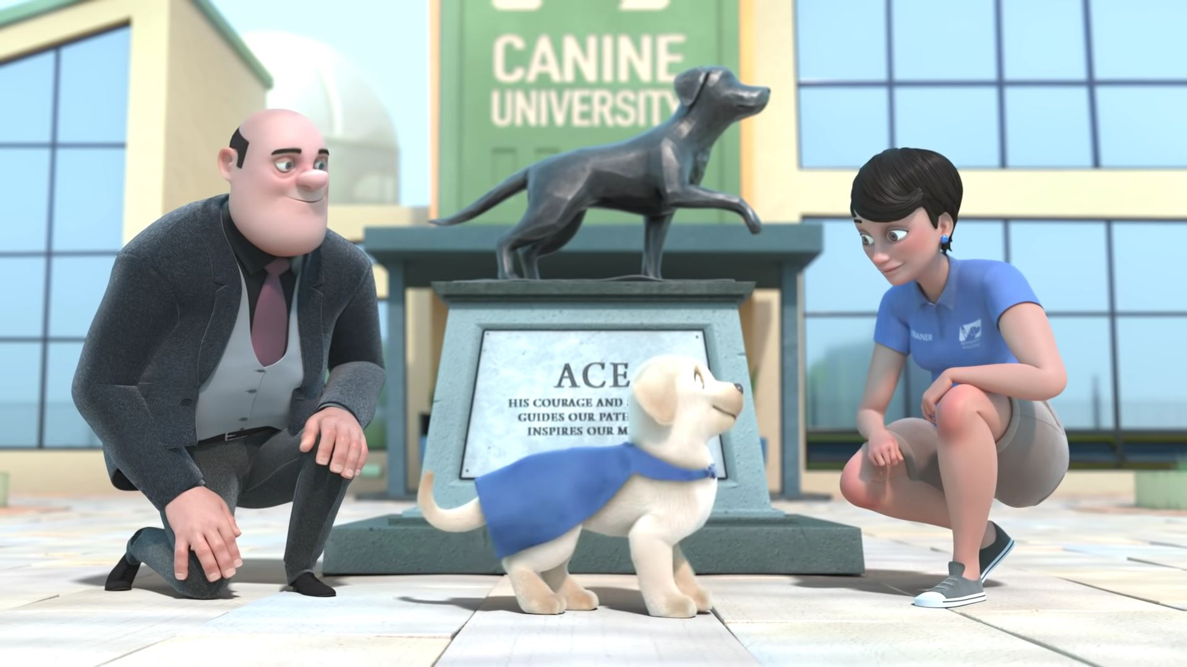
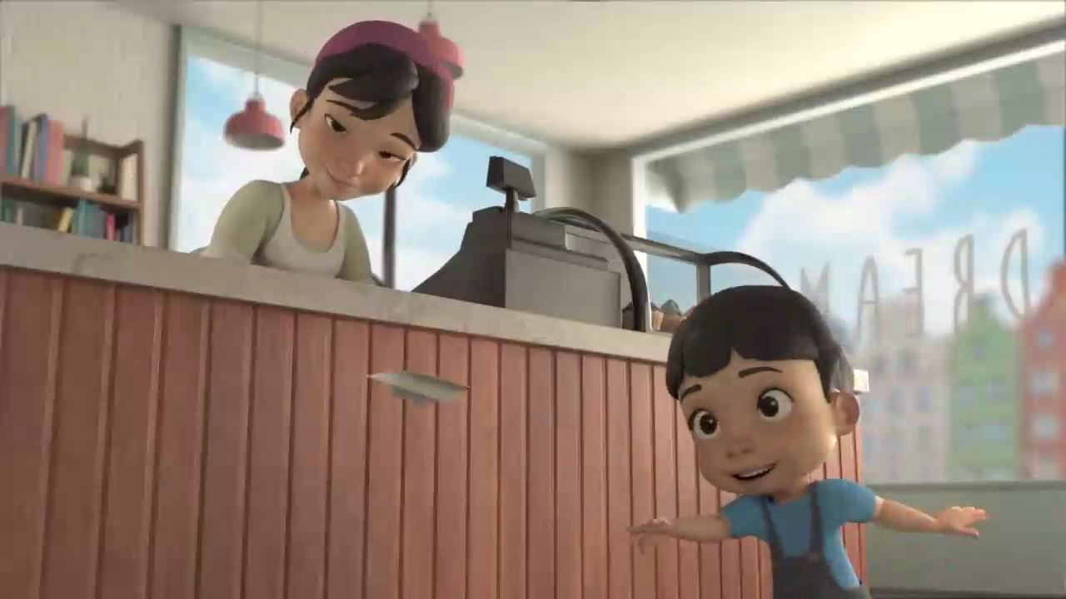
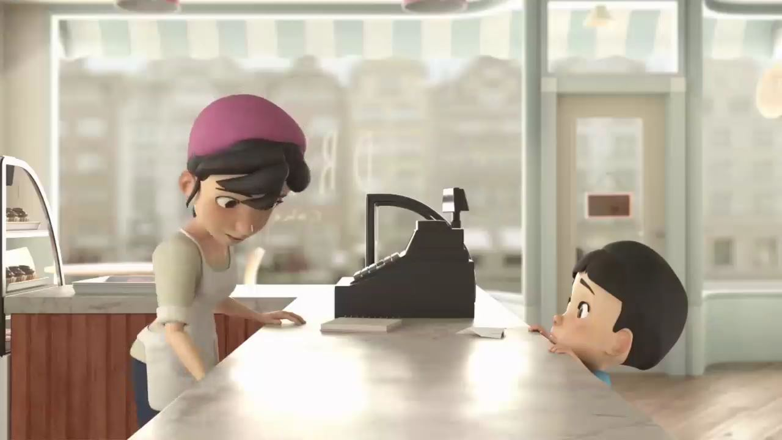





Language Development and Event Boundaries
in Children’s Episodic Memory
Chaeyoung Lee, advised by Yu Jin Rah and Dr. Sang Ah Lee
Developmental Cognitive Neuroscience Lab
College of Nursing | Seoul National University | leecy0130@snu.ac.kr
INTRODUCTION
RESULTS
Episodic Memory & Event Boundary¹⁻²
- Age ↑ Recall & Cognitive sophistication ↑
- Event boundaries(Spatial & Contextual shifts)
structure episodic memories via hippocampal processing
Language Development & Free Recall³⁻⁴
- Language supports episodic memory
- Advanced language skills improve free recall
Natural Language Processing⁵⁻⁷
- Embedding: Vectorization by processing languages
- Cosine Similarity: Cosine of the angle between the vectors
(A . B) / (||A|| * ||B||)
〮 SBERT: Sentence embedding - contextual & semantic precision
〮 Word2Vec: Word associativity through semantic embedding
〮 TF-IDF: Term frequency using document relevance
Demographic : No Significant Differences in Age & Sex
Cosine Similarity |  | Language Development
Age | Sex | Age | Sex
Cosine Similarity
Language Score
Age 7
Age 8
Male
Female
Age 7
Age 8
Male
Female
2. Language Development ↑ Recall Accuracy ↑
Cosine Similarity
Cosine Similarity
r = -0.03 ^{ns}
OBJECTIVES
Language Score
To examine relationship between the level of language development and memory recall in children
2. To investigate the effects of event structures
on children’s memory recall
by measuring cosine similarity with NLP
SBERT : r = 0.55***
Word2Vec : r = 0.47**
TF-IDF : r = 0.40*
Correlation between Language devl & Recall acc.
METHODS
No significant correlation between language devl & nonverbal memory
Cosine Similarity Average
Participants
: 34 Children aged 7~8 years (18 girls), mean (SD)_{age} = 7.90 (0.60)
Experimental Design & Procedure
8 Video Conditions (~1 min each)
- 2 (Spatial shift O vs. X) - 2 (Causal vs. Parallel)
- 2 (Character: Animal vs. Human)
Measurements
1. Recall Accuracy: Cosine Similarity
Compare children’s free recall text with answer sheet
2. Language Development Level
: Number of total〮unique words & words per sentence,
Variety of words, Average sentence length, Grammatical complexity,
Proportion of compound sentences,
& parts of speech (nouns, verbs, adjectives, adverbs)
Cosine similarity with SBERT effectively measures Accuracy in Free Recall
by considering Sentence-level Meaning and Context + Richness of Content → Suitable for analyzing correlation (Language devl & Recall accuracy)
8 Video Encoding
Free Recall
Sequence / TOJ / Recognition
3. Parallel, Spatial shift X Event : Recall Accuracy ↑
: Spatial boundary becomes cue to recall parallel events
→
→
Recall Accuracy in Free Recall | Temporal Memory Accuracy
†
 | Spatial shift O | Spatial Shift X
Causal
Parallel
+ No significant difference in Sequence
Without Spatial Boundary : Recall Accuracy ↑
Explain more details (e.g. colors, quantities)
With Spatial Boundary :
With Causal context, Spatial Boundary interrupt Recall
With Parallel context, Spatial Boundary provide cues to Recall
ACKNOWLEDGMENT
DISSCUSION
This work was supported by the National Research Foundation of Korea (NRF) funded by the Korea government (MSIT; No. 2023R1A2C2005587), Creative-Pioneering Researchers Program through Seoul National University (SNU) (339-20230014), the Institute of Information & Communications Technology Planning & Evaluation (IITP; No. 2019-0-01371-003), and SYEDU (Multisensory Learning and Memory).
Confirms and supports research by Benear(2024)
“Advanced Language skills improve Free Recall by organizing event details & context”
- Due to the small sample size, it is difficult to generalize the results of the study.
More samples of different age groups are needed for further research.
Reference
1. Ghetti, S., & Lee, J. K. (2011). Children’s episodic memory. Wiley Interdisciplinary Reviews: Cognitive
2. Clewett, D., DuBrow, S., & Davachi, L. (2019). Transcending time in the brain: How event memories are constructed from experience. Hippocampus
3. Benear, S. L., Onwukanjo, O. J., Olson, I. R., & Newcombe, N. S. (2024). Children’s Memory for Events: The Challenge of Free Recall.
Journal of Cognitive Neuroscience
4. Gathercole, S. E., Pickering, S. J., Ambridge, B., & Wearing, H. (2004). The structure of working memory from 4 to 15 years of age. Developmental Psychology
5. Nils Reimers and Iryna Gurevych (2019). Sentence-BERT: Sentence Embeddings using Siamese BERT-Networks. Ubiquitous Knowledge Processing Lab
.
6. Mikolov, T. (2013). Efficient estimation of word representations in vector space. arXiv preprint arXiv:1301.3781, 3781.
7. SPARCK JONES, K. (1972), "A STATISTICAL INTERPRETATION OF TERM SPECIFICITY AND ITS APPLICATION IN RETRIEVAL", Journal of Documentation
8. Shing. Y. L., Markus Werkle-Bergner, Yvonne Brehmer, Viktor Müller, Shu-Chen Li, Ulman Lindenberger (2010). Episodic memory across the lifespan: The contributions of associative and strategic components. Neuroscience & Biobehavioral Reviews
9. Radvansky, G. A., & Zacks, J. M. (2017). Event boundaries in memory and cognition. Current Opinion in Behavioral Science
10. Corballis, M. C. (2019). Language, memory, and mental time travel: An evolutionary perspective. Frontiers in Human Neuroscience
11. International Journal of Learning, Teaching and Educational Research

Slide 2
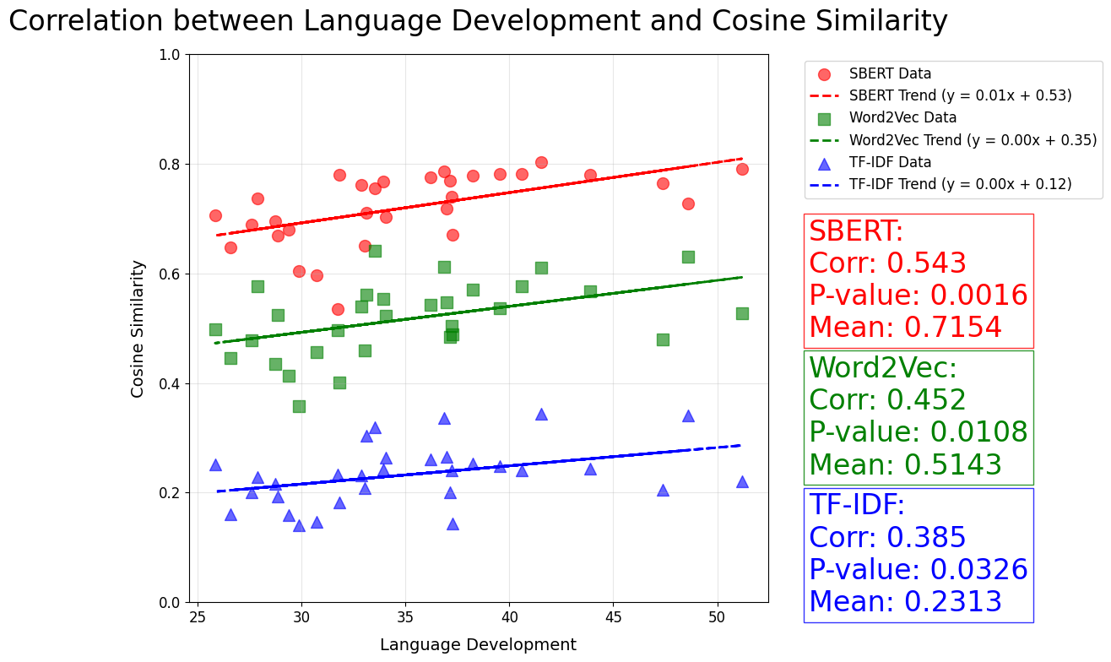
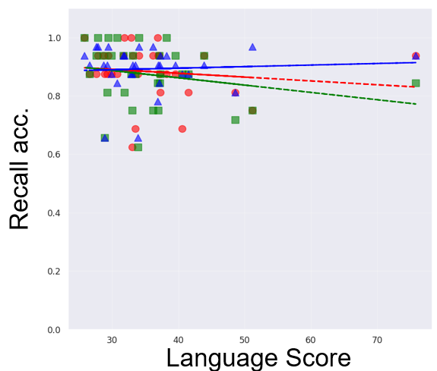
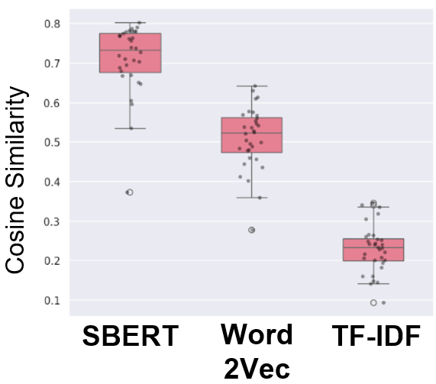
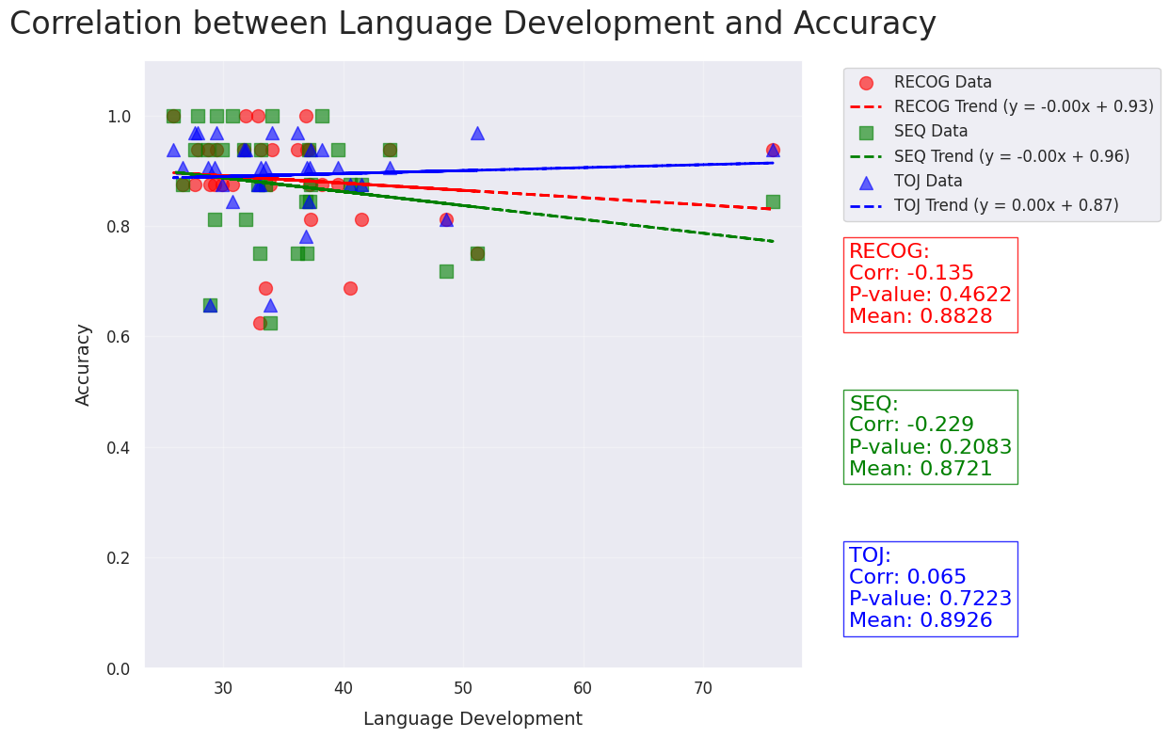
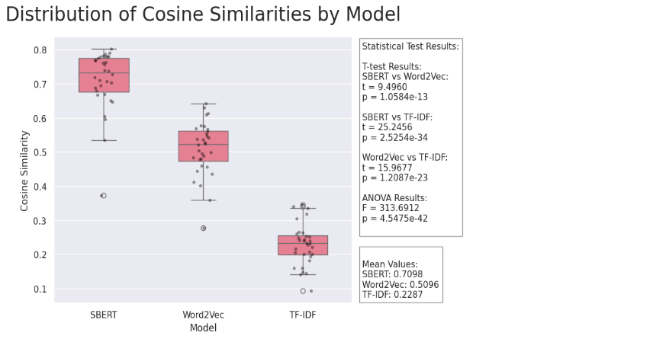
Correlation (Language Devl. & Recall Acc.)
SBERT : r = 0.54**
Word2vec : r = 0.45*
TF-IDF : r = 0.39*
Recall acc.
Cosine Similarity Mean by Models
Language Score
Cosine Similarity
SBERT
Word
2Vec
TF-IDF
Cosine Similarity Mean by Models
* SOCO < SXCX : t = 2.59, *p = 0.0796
* SXCO < SXCX : t = 2.37, *p = 0.0306
- Spatial Shift O & Causal O Event (SOCO)
: Focused on Overall storyline, Details ↓ (e.g., colors, quantities)
: Prioritized Character’s Actions > Spatial shift → Recall Accuracy ↓
- Spatial Shift X & Causal X (Parallel) Event (SXCX)
: Consistent storyline X → More Detailed descriptions of specific elements
→ Higher Similarity with Answer sheet (Recall Accuracy ↑ in Free Recall)
↔ Lowest Recall Accuracy in TOJ

